Slide 1
PTDevSuite
by HANTZ + PARTNER

Slide 2
PTDevSuite Uses
PTDevSuite components are used in numerous photo, medical, and kiosk applications
  Primera uses PTRobot in the Optivault Archival Appliance.
  Primera uses PTBurn SDK as a part of our PTBurn network software.

Slide 3
PTDevSuite Components
PTBurn
  Text File Interface
  Burn Engine Included
  Implemented via a shared “hot” folder
  For use in applications where you want to quickly integrate automated burning/printing via an external application.
PTRobot
  C Based DLL Interface
  No Burn Engine (Robotics Only)
  Implemented via calls to an API
  For use in applications where you have a burning engine and want full control of the robotics without an running a separate application.

Slide 4


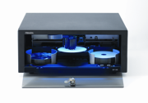
PTDevSuite Components: PTBurn
Your Application
PTBurn
Data and Print File
PTBurnJobs
Copy/Reference
C:\MyTest\
Control
Job Request File
Copy
Data=C:\MyTest\
PrintLabel = C:\myTest.std

Slide 5
PTDevSuite Components: PTRobot
Your Application
PTRobot
PTRobot_EnumRobots
PTRobot_EnumDrives
PTRobot_LoadDrive
PTRobot_LoadPrinterFromDrive
Control
PTRobot_PrintFile
PTRobot_UnloadPrinter

Slide 6
PTBurn Capabilities
Support for BravoII, BravoXR, BravoPRO, and ComposerMAX
Automated Burn and printing of Data, Audio, and Disc Image jobs
  Audio: CDText
  Data: Premastering
  Image: Supports .iso and .gi image formats
Perform automated Print and Read Disc Jobs
  Read Data/Audio to a folder, or create an image
Supports Manual Load and Unload
  Allows the developer to perform Pre/Post burn operations (Special Verification, etc)
Mulit-session burning
  Mixed mode, Enhanced CD, etc.
Simultaneous burning and printing of multiple jobs.

Slide 7
PTRobot Capabilities
Support for BravoII, BravoXR, and BravoPRO
Robotic Control through C Based API
  PTRobot_LoadDrive
  PTRobot_LoadPrinter
  PTRobot_PrintFile
  Etc…
No additional application necessary
Handles multiple robots simultaneously
Provides Error strings in English, Spanish, Italian, French, German, and Japanese

Slide 8
PTBurn vs. PTRobot
Questions to consider???
  Does the developer have their own burn engine?
    Do they need a burn engine (Print Only applications)?
  Does the developer need a solution with no user interface other than their own?
  Does the developer need a solution that supports multiple robots from the same app?
  Does the developer have programming experience?

Slide 9
PTBurn vs. PTRobot (Continued)
PTBurn provides less control over the operations but is much easier to implement
  Days of programming effort
PTRobot provides complete control over operations but is harder to implement
  Weeks of programming effort

Slide 10
How to Get PTDevSuite
http://www.primera.com/software_upgrade.html
  Username: supportsdk
  Password: sdk191
SDK Includes
  PTBurn
    Full application and installer
    Documentation
    Full Source Code for a sample client application
  PTRobot
    DLLs
    Documentation
    Full Source Code for a sample application

Slide 11
Support for PTDevSuite
PTDevSuite is supported by Primera’s technical support group
To assist the support group ensure logging is on at a high level when the issue occurs
Run a technical support report on the machine where the issue occurs
  http://www.primera.com/software_upgrade.html
    “Tech Support Report Utility”
For PTBurn, provide the jrq file that causes the issue
Search Primera’s knowledgebase prior to calling/emailing tech support
  http://www.primera.com/knowledgebase.html

Slide 12
PTBurn in Detail
by HANTZ + PARTNER

Slide 13
PTBurn: Components
PTBurn is made up of the following components
  Sample Client App
  PTBurn Application
    This is the server APPLICATION. It must be running on computer connected to the robot for the SDK to function.
  Shared Folder
    Located at \\ComputerName\PTBurnJobs
  Status File
  Log File
  Ini Files
  Job Request Files (JRQ Files)
    Contain the job description

Slide 14
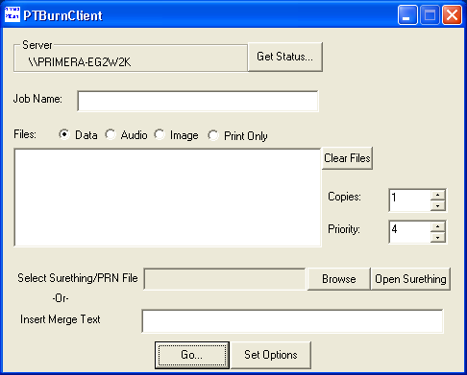
PTBurn Components: Sample Client APP

Slide 15
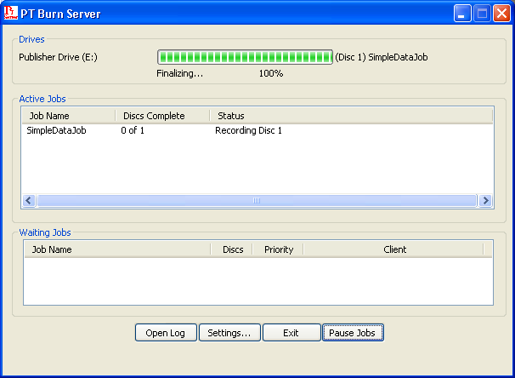
PTBurn Components: Application
This text represents the job and Disc number within the job that is currently in the drive
This area displays the burn percentage and the stage that the burning is in.
This area displays all active jobs in the system (.inp jobs)
This area displays all discovered but waiting jobs in the system (.qrj jobs)

Slide 16
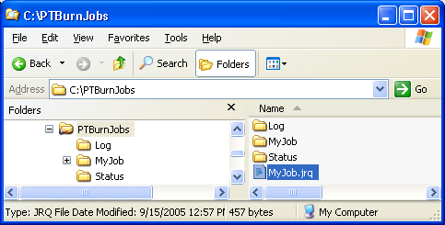
PTBurn Components: Shared Folder
Created the first time the PTBurn Server is launched.
Critical to the SDK functioning properly.
Contains all status and log info.
  PTStatus.txt is located in the “Status” folder.
  PTLog.txt is located in the “Log” folder.
Location where ALL job request (jrq) files are placed.

Slide 17
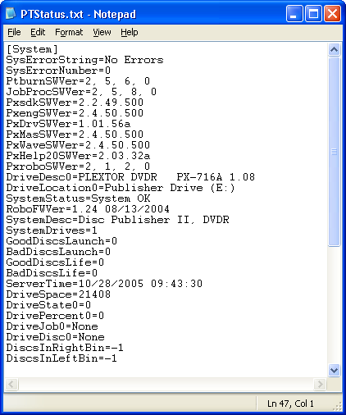
PTBurn Components: Status File (System Info)
PTStatus.txt
  System Info

Slide 18
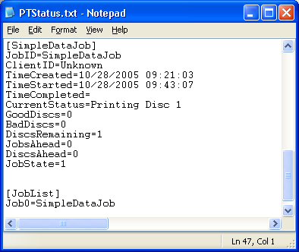
PTBurn Components: Status File: (Current Job Info)
PTStatus.txt
  Current Job Info

Slide 19
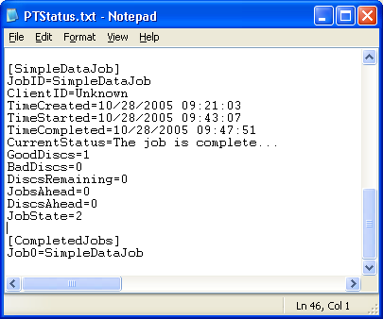
PTBurn Components: Status File: (Completed Job Info)
PTStatus.txt
  Completed Job Info

Slide 20
PTBurn Components: Log File (PTLog.txt)
The log file contains important info for debugging issues.
  You can control the amount of log info via the LogLevel key in the PTSetup.ini file.
  When submitting log files to Primera’s Technical Support we require that the log level be set to 5.
Sample PTLog.txt logging at Level 1
Sample PTLob.txt logging at Level 5

Slide 21
PTBurn Components: Ini Files
PTBurn settings are controlled by two main INI files
  PTSetup.ini
    Contains application settings
    Example of PTSetup.ini
  Disc Publisher XR_CFG.ini
    Contains robotic settings
    This file is named based on the printer name.
    Example of Disc Publisher XR_CFG.ini

Slide 22
PTBurn Components: JRQ Files
JRQ Files are used to specify the job to the server (myJob.jrq)
When the job is found by the server the extension is changed to .qrj (myJob.qrj)
When the Job is “in process” the extension is changed to .inp (myJob.inp)
When the job is complete the extension is changed to .don, .err, or .abt.

Slide 23
PTBurn Components: JRQ File Contents
Contains Keys to define the job to the server.
  General Job Keys
    JobID, ClientID, Importance, DiscType, DeleteFiles, CloseDisc, PrintLabel, Copies, VerifyDisc…
  Data Job Keys
    Data, VolumeName, DataImageType, Close Disc, PreMasterData…
  Audio Job Keys
    AudioFile, CDTextDiscTitle…
  Image Job Keys
    ImageFile, ImageType…
  And Many More (See Section 2.1 of the SDK documentation for all the available keys)…

Slide 24
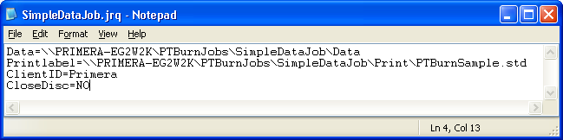
PTBurn: Our first Job
Simple JRQ File
This will create one Disc with the data that is contained in the folder SimpleData\Data, using all other default values, and print the file SimpleData\Print\SimpleData.std

Slide 25
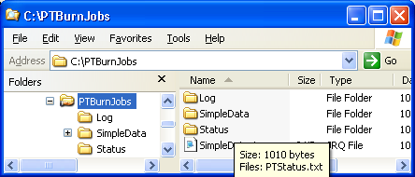
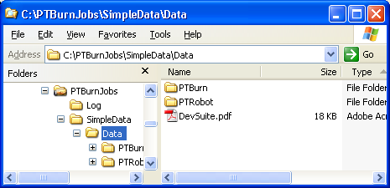
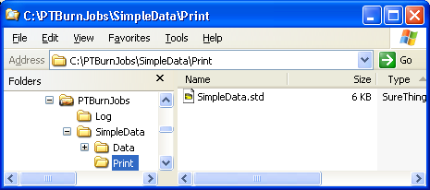
Our first Job: Submitting the Job
Copy the files/folders used in the job to the “hot” folder
Now Copy the JRQ file
  Note: Make sure to copy all the data first
It is a best practice to create a separate folder for each job, with one subfolder for data and one for print

Slide 26
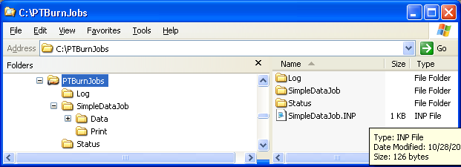
Our first Job: Job Starts
Once the job is in process the jrq file will change from .jrq to .inp.
The status file will change to reflect the fact that the job is in process.

Slide 27
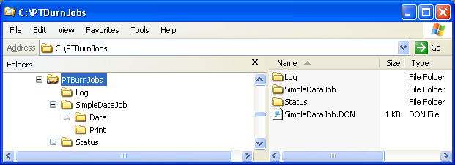
Our first Job: Job Completes
When a job completes the .inp file extension changes to .don/.err/.abt.
PTStatus.txt changes to reflect this.

Slide 28
PTBurn: MultiSession Data Job (Many Options)
This job will display some of the many options that are supported for a data job including…
  JobID, ClientID, DeleteFiles, DataImageType, CloseDisc, Copies, VolumeName, VerifyDisc, NotifyClient
This job will also display the Multisession capabilities of PTBurn
JRQ File…

Slide 29
PTBurn: Audio Job CDText
This job will display the Audio capabilities of PTBurn including…
  Audio file formats supported
  Pre-gap specification
  CD Text Support
JRQ File…

Slide 30
PTBurn: Print Only Job
This example will show how to perform a print only job
JRQ File…

Slide 31
PTBurn: Read Disc Job
This example will show how to read data from a disc into a location on the network
  Discs can be read as Data, into a global image format, or as audio tracks
JRQ File…

Slide 32
PTBurn: Check File on Disc Job
This example will show you how to check if a file is on the disc prior to starting the burn/read
JRQ File…

Slide 33
PTBurn: Manual Load/Unload
This example will show how to utilize the manual load/unload features
Manual load/unload allows the developer to control the loading/unloading of a disc in order to perform some operation on the disc
  After the disc is loaded the server enters a wait state.
  Your application would perform some operation on the blank disc and then allow it to exit the wait state by sending a command to the server.
  The operation specified in the jrq file (burning, reading, etc) would start.
  When finished the server would again enter a wait state.
  Your application would perform some operation on the burned disc and then allow it to exit the wait state by sending a command to the server
JRQ File…

Slide 34
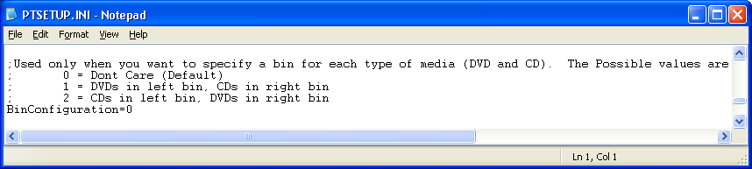
PTBurn: CD/DVD Bin Selection
This example will show how to utilize the CD/DVD bin selection functionality in PTBurn
  This feature allows you to specify one bin for DVDs and one bin for CDs and then in the job specify if the job uses CDs or DVDs.
  In order to use this feature you need to update the PTSetup.ini file.
CD JRQ File
DVD JRQ File

Slide 35
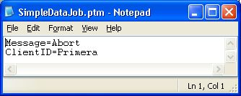
PTBurn: Job Commands
Abort
  To abort SimpleDataJob.jrq you must create SimpleDataJob.ptm with the following contents…
  Copy the SimpleDataJob.ptm into the PTBurnJobs folder.
Abort Job Example

Slide 36
PTBurn: System Commands
For all system command the Client key must ALWAYS be Administrator
Shutdown after job
  Shuts down PTBurn after all in process jobs are complete
Shutdown Immediate
  Shuts down PTBurn immediately
  Show Example
Check Bins
  Checks the bins to see how many discs are left in each
Align Printer
  Aligns the printer (Only on the BravoPRO)
Ignore Ink Low
  Ignores the ink low command (Only on the BravoPRO)

Slide 37
PTBurn Common Debugging Steps
Make sure Shared folder is visible from the computer that is submitting the job
Check formatting of JRQ File
  Check the log file for any errors
Check for proper robotic function by using PrimoDVD

Slide 38
PTBurn: Deployment
Easy Way
  The simplest way to deploy PTBurn is to call our installer to install the server software
Harder Way
  If you want to integrate the installation of PTBurn into your installer you must install the PTBurn files and registry keys in specific locations
  Details about these locations can be found in Appendix B of the “PTBurn SDK” documentation

Slide 39
Questions??
Send your request to: info@hantz.com

Slide 40
PTRobot in Detail
by HANTZ + PARTNER

Slide 41
PTRobot Components
PTRobot is made up of the following components
  Sample Application
  DLLs
    PTRobot.dll
      Main API DLL
    PTRobotDP.dll
      Disc Publisher XR / II module
    PTRobotDPPRO.dll
      Disc Publisher PRO module
    PTRobotStr.dll
      String module containing strings localized in English, German, French, Spanish, Italian, and Japanese
  Header/Library Files
  SureThing
    Requires Surething to be installed to support printing.

Slide 42
PTRobot: Sample Application
PTRobot comes with complete source code for a sample application that will move and print discs
  C++ Visual Studio 2003 application.
  Shows ALL the functionality of PTRobot.
  Supports simultaneous operations on multiple robots.

Slide 43
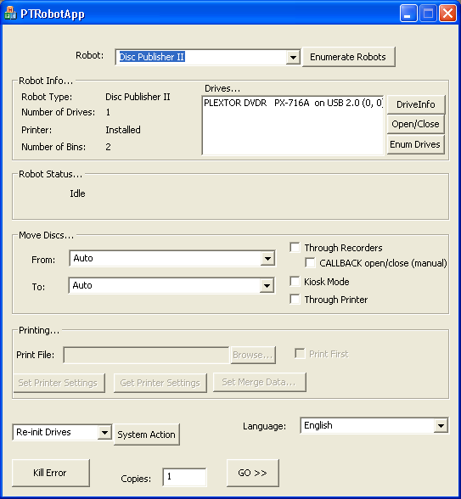
PTRobot: Sample Application

Slide 44
PTRobot: Sample Application
The sample application should be your first resource when debugging an issue with PTRobot
  If you find that the issue exists in the sample application then it should be brought up with Primera’s technical support group
Almost all functionality is demonstrated.

Slide 45
Header/Library Files
PTRobot.h
  Header file containing the complete PTRobot API
PTRobot.lib
  Library file allowing the developer to statically link PTRobot

Slide 46
PTRobot Coding Examples
by HANTZ + PARTNER

Slide 47
PTRobot Usage: Startup
At program startup:
PTRobot_Initialize(..)
PTRobot_EnumRobots(..)
- if the number of robots is greater than 1 then the calling application will need to provide some logic/ui to determine which robot to use. The app can use PTRobot_GetRobotInfo(..) to get details about each robot.
PTRobot_EnumDrives(..)
- This will cause PTRobot to determine which drives are robotically controlled by enumerating the drives themselves.
PTRobot_GetDriveInfo(..) for all drives returned
- This will allow the calling app to know which drive is which

Slide 48
PTRobot Usage: Doing a Job
PTRobot_LoadDrive(Robot, Drive, TRUE)
- This will load a disc into the drive from the input bin
(should set parameter 3 to TRUE if first round of the job)
PTRobot_GetRobotStatus(..)
- This would be called in a loop until a system error occurred or the system is idle.
…Client application will now perform operations on the disc in the drive (e.g. record on the disc).
if the operations are successful
PTRobot_LoadPrinterFromDrive(Robo, Drive)
PTRobot_GetRobotStatus(..) called in a loop
PTRobot_PrintFile(szPrintFile) or PTRobot_PrintFileWithMerge(…)
PTRobot_GetRobotStatus(..) called in a loop
PTRobot_UnloadPrinter(Robot, 0)
PTRobot_GetRobotStatus(..) called in a loop
else
PTRobot_UnloadDrive(Robot, Drive, 100)
PTRobot_GetRobotStatus(..) called in a loop

Slide 49
PTRobot Usage: Exit
Before program exit:
PTRobot_Destroy()

Slide 50
PTRobot: Enumerating Robots
DWORD WINAPI PTRobot_EnumRobots(HANDLE * phRobots, DWORD * pdwNumRobots);
You pass to this function a pointer to an array of HANDLEs and the size of the array.
If this function is successful the pdwNumRobots param will contain the number of robots found and the phRobots will contain the handles to those robots.
You should use PTRobot_GetRobotInfo(HANDLE hRobot, PTRobotInfo *pRobotInfo) to get the robotic info listed below
  HANDLE hRobot; //Robot Handle
  TCHAR tszRobotDesc[100]; //Robot Description
  DWORD dwRobotType; //See "Robot Type" section 4.4
  DWORD dwNumDrives; //Number of Recorders on this robot
  DWORD dwNumPrinters; //Number of Printers on this robot (0 or 1)
  DWORD dwNumBins; //Number of Bins on this robot
  DWORD dwDriveColumns; //Number of Drive Columns
  DWORD dwDriveRows; //Number of Drive Rows
  TCHAR tszRobotFirmware[20]; //String Containing the FW Version of the Robot
  DWORD dwOptions; //See "Robot Options" section 4.6
  DWORD dwAction; //See "Robot Actions" section 4.7
  HANDLE hDrives[10];
  DWORD dwDriveBusType; //BusType of the Drives
The robot handle is used throughout PTRobot to specify which robot to perform an operation on.

Slide 51
PTRobot: Enumerating Drives
DWORD WINAPI PTRobot_EnumDrives(HANDLE hRobot, HANDLE * phDrives, DWORD * pdwNumDrives);
You pass to this function the handle of the robot for which to enumerate the drives, a pointer to an array of HANDLEs, and the size of the array
If this function is successful the pdwNumRobots param will contain the number of drives found and the phDrives will contain the handles to those robots
You should use PTRobot_GetDriveInfo(HANDLE hDrive, PTDriveInfo *pRobotInfo) to get the drive info listed below
  HANDLE hDrive; //Drive Handle.
  TCHAR tszDriveName[132]; //Drive String (reported from drive)
  TCHAR tszFirmwareVer[40]; //Drive FW version
  TCHAR tszSerialNum[40]; //Drive Serial Number
  HANDLE hRobot;
  DWORD dwDriveColumn; //Drive Column (0 based - 0 is leftmost column)
  DWORD dwDriveRow; //Drive Row (0 based - 0 is the top row)

Slide 52
PTRobot: Moving Discs
DWORD WINAPI PTRobot_LoadDrive(HANDLE hRobot, HANDLE hDrive, DWORD dwFromLocation, DWORD dwClearDrive);
To load the drive you must pass down the robot handle, the drive handle, the “From” location, and whether or not you want to clear the drive prior to loading
The other loading and unloading commands behave in a similar fashion.

Slide 53
PTRobot: Printing Discs
Uses SureThing to print discs
DWORD WINAPI PTRobot_PrintFile(HANDLE hRobot, TCHAR * tszFile, DWORD dwPrintIndex);
  Function to print the file tszFile on the robot specified by hRobot
DWORD WINAPI PTRobot_PrintFileWithMerge(HANDLE hRobot, TCHAR * tszFile, DWORD dwNumMergeStrings, ...);
  Function to print the file tszFile on the robot specified by hRobot with the merge values defined by the variable arguments.
  Supports merge text and photos.

Slide 54
PTRobot: Getting Status
DWORD WINAPI PTRobot_GetRobotStatus(HANDLE hRobot, PTRobotStatus *pRobotStatus);
After a robotic movement you need to call the get status function in a loop similar to the one below.
While(1)
{
PTRobot_GetRobotStatus(…)
if System is Idle
break out of while loop
else if System is in an error
Get the error string to log or display
if the user clears the error
continue
else if the user chooses to cancel the command
Call PTRobot_SystemAction(hRobot, PTACT_CANCELCMD);
}

Slide 55
PTRobot: Handling Errors
When getting status, if you determine that the system is in an error condition, you should get the error string and display it to the user
The user should be given the choice to correct the error or cancel the command
If the user chooses to correct the error, the status should be continually checked to make sure the user corrected the error
If the system is in an error condition further movements may not be performed until that error is cleared.

Slide 56
PTRobot Debugging Common Issues
The log file should be the main debugging tool.
  The log file is specified by the PTRobot_SetupDebugging function
If you find an issue check to see how the Sample app handles that same issue

Slide 57
PTRobot: Deployment
In order to deploy PTRobot with your solution you need to install the 4 PTRobot dll files
  A best practice would be to install them into the same directory as your executable
  You can either link the dll dynamically or you can link statically using the provided .lib file
SureThing must also be installed

Slide 58
Questions??
Send a mail to: info@hantz.com

